Slide 1
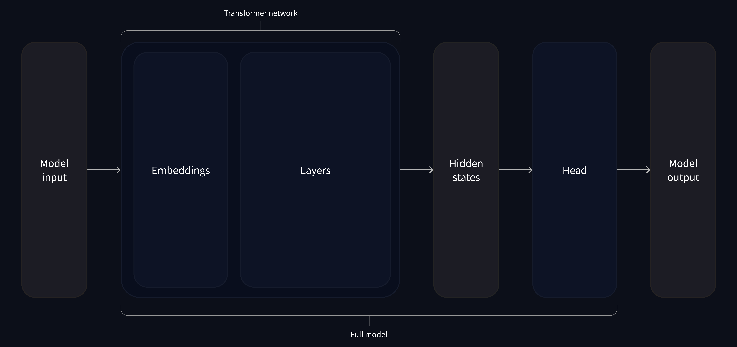
(Attention mechanism)
Vectors
Tensors
Tensors
Logits

